Slide 1
Bugzilla User Guide for Phone Analysis & Design team
Kaisa Harjula
April, 3th 2012
REV 3: WW014 | 2012

Slide 2
Table of Content
General Introduction
Reporting a New Bug
Searching the Assigned Bug
Solving the Assigned Bug

Slide 3
General Introduction 1/2
Bugzilla User Guide includes information how to get access to Bugzilla defect management tool and how to use it
New Account creation
Send a mail to the following mailing list
"EC CCR SHZEC UMG BlackBay Bugzilla Owner“
Portal Access
http://umgbugzilla.sh.intel.com
Help and more information about System Defect Management for Android
http://umgwiki.intel.com/wiki/?title=System_Defect_Management_for_Android
Contact Kaisa Harjula (kaisa.e.harjula@intel.com)
Weekly Bug Report can be found
\\tmnap01a.tm.intel.com\pad\RhB_Defects

Slide 4
General Introduction 2/2
ALWAYS promptly deal with bugs!
Immediately report of a new bug
During 24h reply to a bug assigned to you
Also check regularly if there is bugs to your own design area
Keyword for HW team are:
HW Impact
HW Validation
Designers put bugs to “resolved” state and project’s Bug forum closes them.

Slide 5
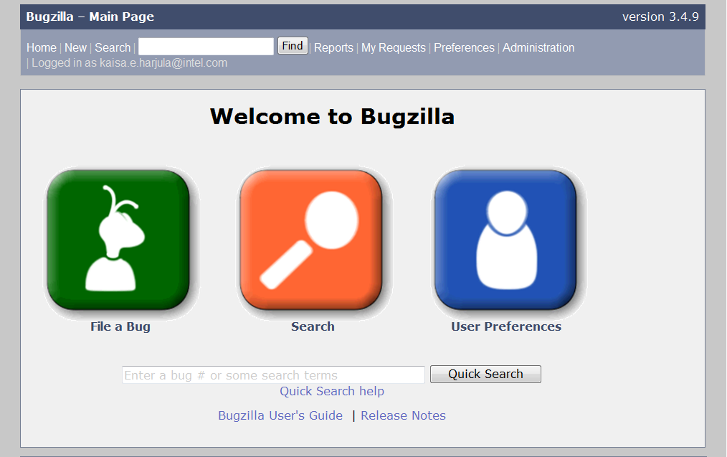
Reporting a New Bug 1/5
Before reporting a new Bug
Search Bugzilla whether your bug has already been reported
Reproduce your bug using a recent build of the software to see whether it has already been fixed
Enter only one bug per report
Report clearly!
Log in to Bugzilla with your Windows user id and password
Main page

Slide 6
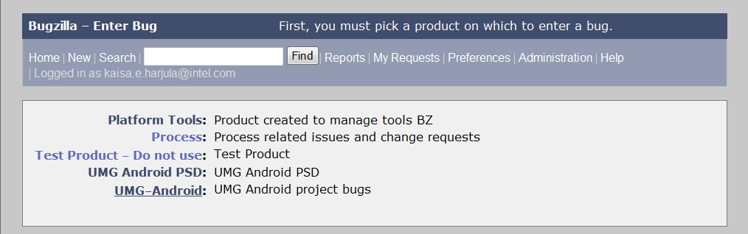
Reporting a New Bug 2/5
Start choosing ”New” or ”File a bug”
Choose next ”UMG-Android”

Slide 7
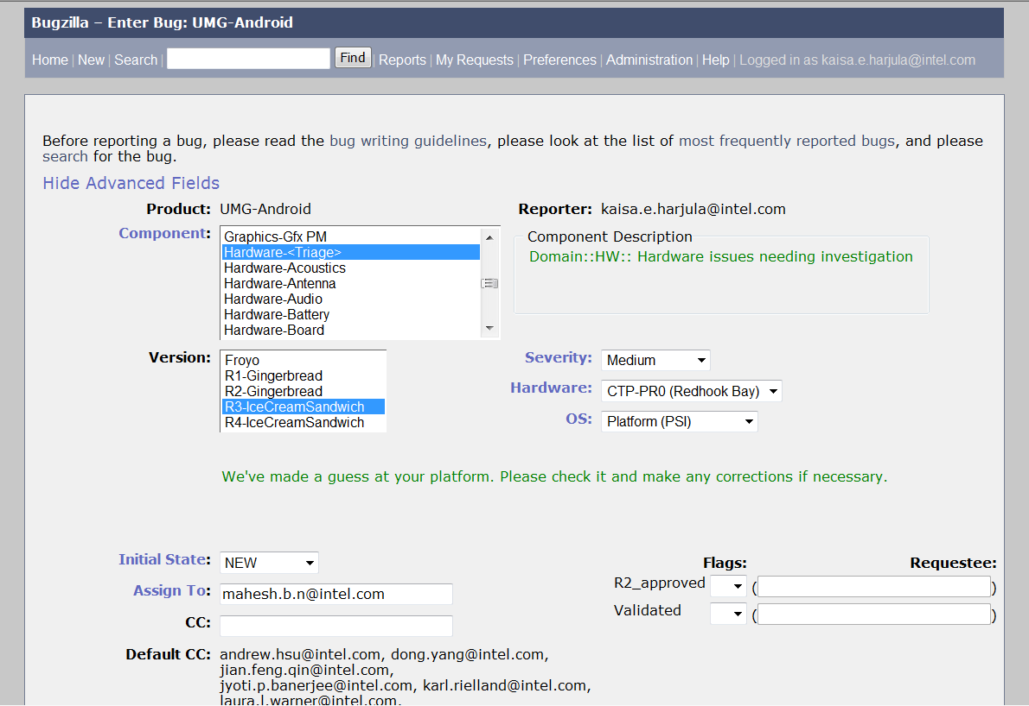
Reporting a New Bug 3/5
Steps 1-8. Red are MANDATORY
1. If the bug is HW bug choose ”Hardware”. If you do not know category choose <Triangle>
3. Choose Severity. Severity Definition instructions
2. Choose ”R3-IceCreamSandwitch”
4. Choose ”CTP-PR? (Redhook Bay)”
5. Choose ”Platform (PSI)”
7. Put main responsible’s name ”To” and minor responsibles ”CC”. Also put mailing list rhb.hw.bugzilla.notification@intel.com to “CC” if it is missing from default.
Guide::
HW area’s responsible Engineers.
6. Reporter chooses ”New” or Assignee chooses ”Assigned”. User Definitions instruction.

Slide 8
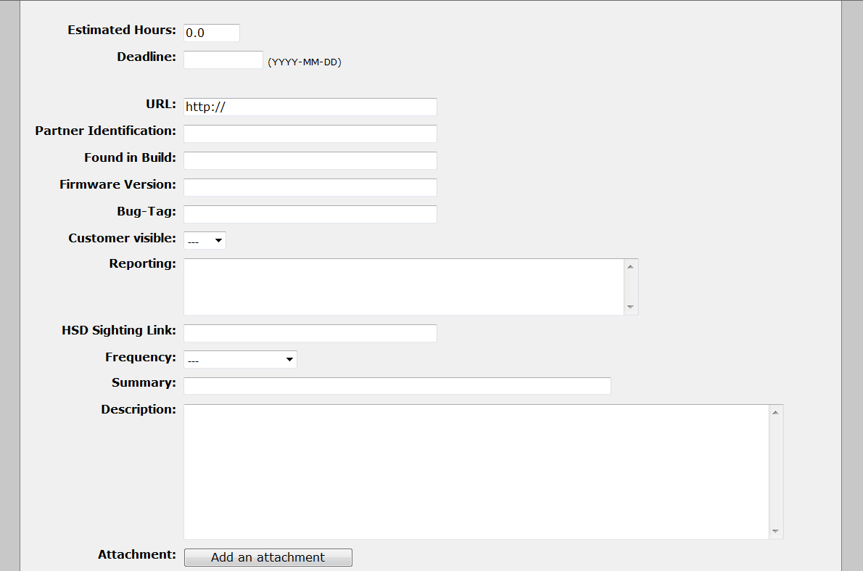
Reporting a New Bug 4/5
Steps 8-14. Red are MANDATORY
8. Target time
9. SW version
10. Bug visibility for customer can be chosen
11. The occurence of the bug
12. The one-line bug description. Summary is the title of the bug
13. Descripe the bug clearly and widely enough
14. Add the bug related documents

Slide 9
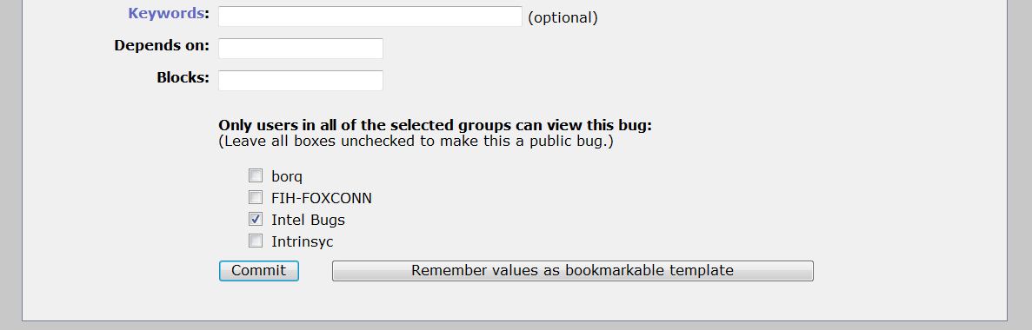
Reporting a New Bug 5/5
Steps 15-18. Red are MANDATORY
15. Add Keyword to get more visibility for a Bug.
Click Keywords in Bugzilla to see the list of Keywords.
16. ID of depending or blocking bug
17. Select the visibility of the bug. Check ”Intel Bugs” and other if informatio must be shared to subcontractors
18. Add the bug to the Bugzilla

Slide 10
Searching the Assigned Bug 1/3
To search bugs that are your responsibility
If you know the bug’s number add it to ”Quick search”
If you want to find all of your bugs
select ”Search” OR ”User Preferences”

Slide 11
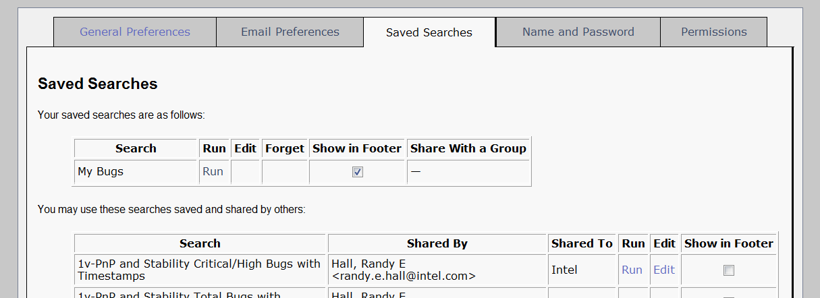
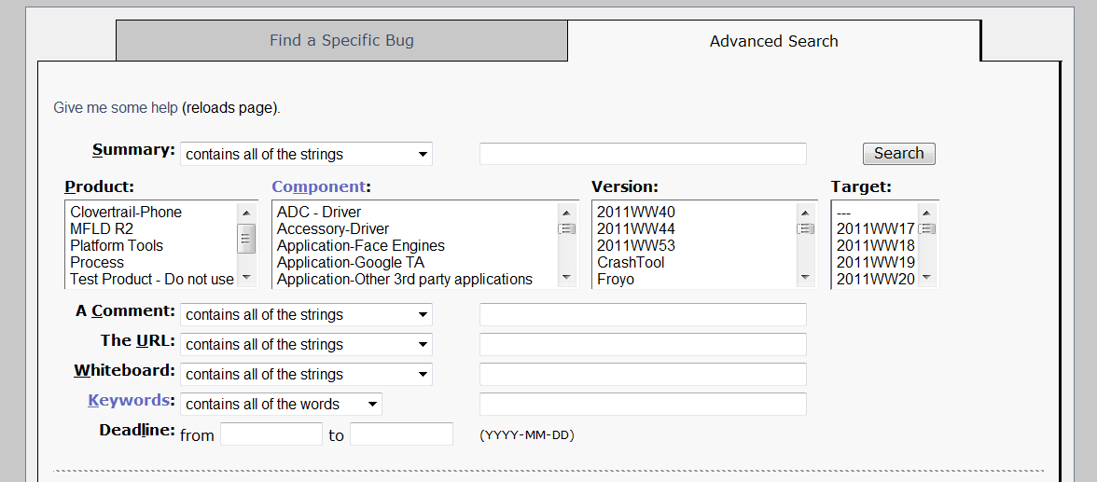
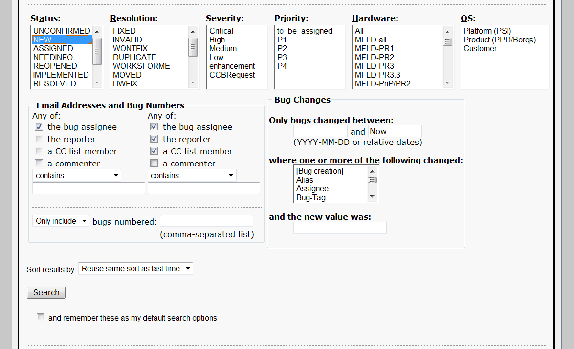
Searching the Assigned Bug 2/3
If You choosed ”User Preferences”:
Choose ”Saved Searches” page
Click ”Run” to ”My Bugs”
If You choosed ”Search”:
Choose ”Advanced Search” page
You just have to choose:
One ”Status” or more
From ”Email Addresses and Bug Numbers”:
Click all boxis of ”Any of”
Add your Email
Click ”Search”

Slide 12
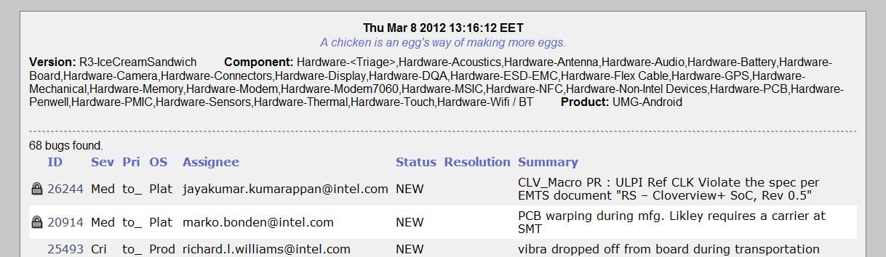
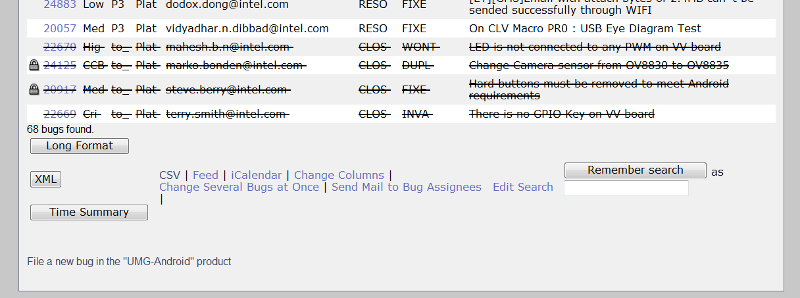
Searching the Assigned Bug 3/3
Search criterions can be named and saved for next search from the end of Search result page. Saved searches can be found from ”User Preferences” page like ”My Bugs” which guidange was at the slide 10.

Slide 13
Searching Design Area’s Bugs 1/3
To search your design area’s bugs select ”Search”

Slide 14
Searching Design Area’s Bugs 2/3
Choose ”Search”:
Choose ”Advanced Search” page
Product: choose UMG-Android
Component: choose your design area
Keywords: Add a keyword if needed. List of Keywords can be found by clicking ”Keywords”.
Status: Choose one or more
Hardware: Choose all CTP-* products
Click ”Search”

Slide 15
Searching Design Area’s Bugs 3/3
Search criterions can be named and saved for next search from the end of Search result page. Saved searches can be found from ”User Preferences” page like ”My Bugs” which guidange was at the slide 10.

Slide 16
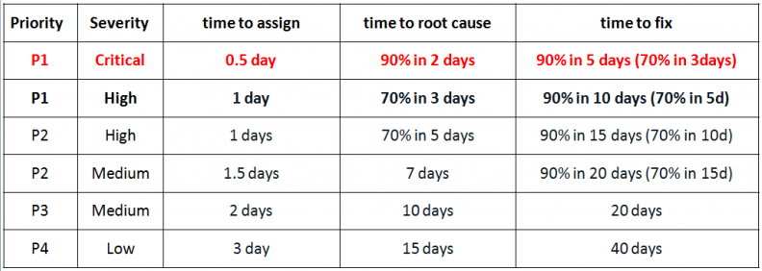
Solving the Assigned Bug 1/3
When getting a bug:
React to bug as soon as possible
ALWAYS fill the red parts that are shown in the next slides
Response times to assign, resolve and fix a bug:

Slide 17
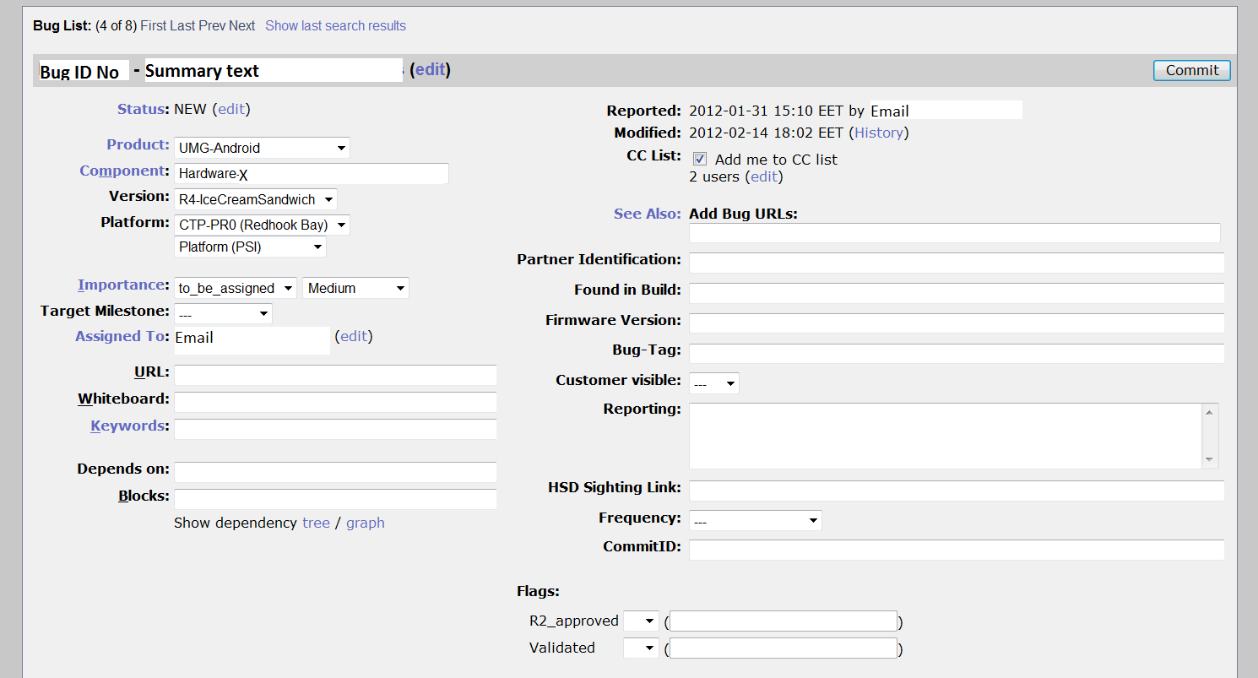
Solving the Assigned Bug 2/3
Steps 1-4. Red are MANDATORY
Change Priority value.
Priority Definitions
2. Set Target
3. Change assignee if needed
4. Add a Keyword if needed. Click ”Keyword” to see list of Keywords

Slide 18
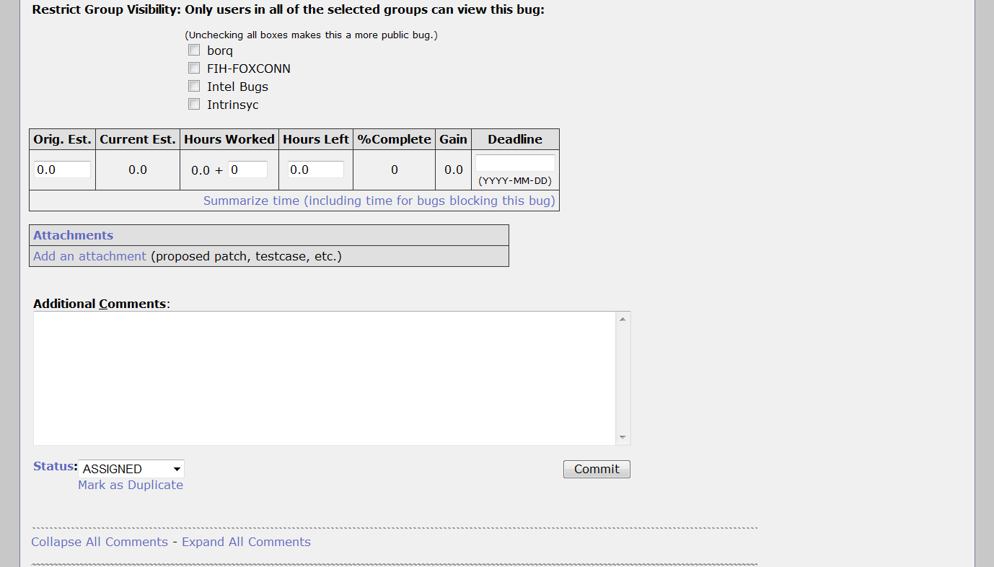
Solving the Assigned Bug 3/3
Steps 5-9. Red are MANDATORY
5. Select the visibility of the bug
6. Add Attachments if needed
7. Comment the bug and it’s solution
9. Send response to the Bugzilla
8. Change the status from ”NEW” to ”Assigned” / ”Implemented” / ”Resolved” / ”Needinfo” or mark it as ”Duplicate”. Mark also reason if status is ”Resolved”.
Status definitions

